Slide 1
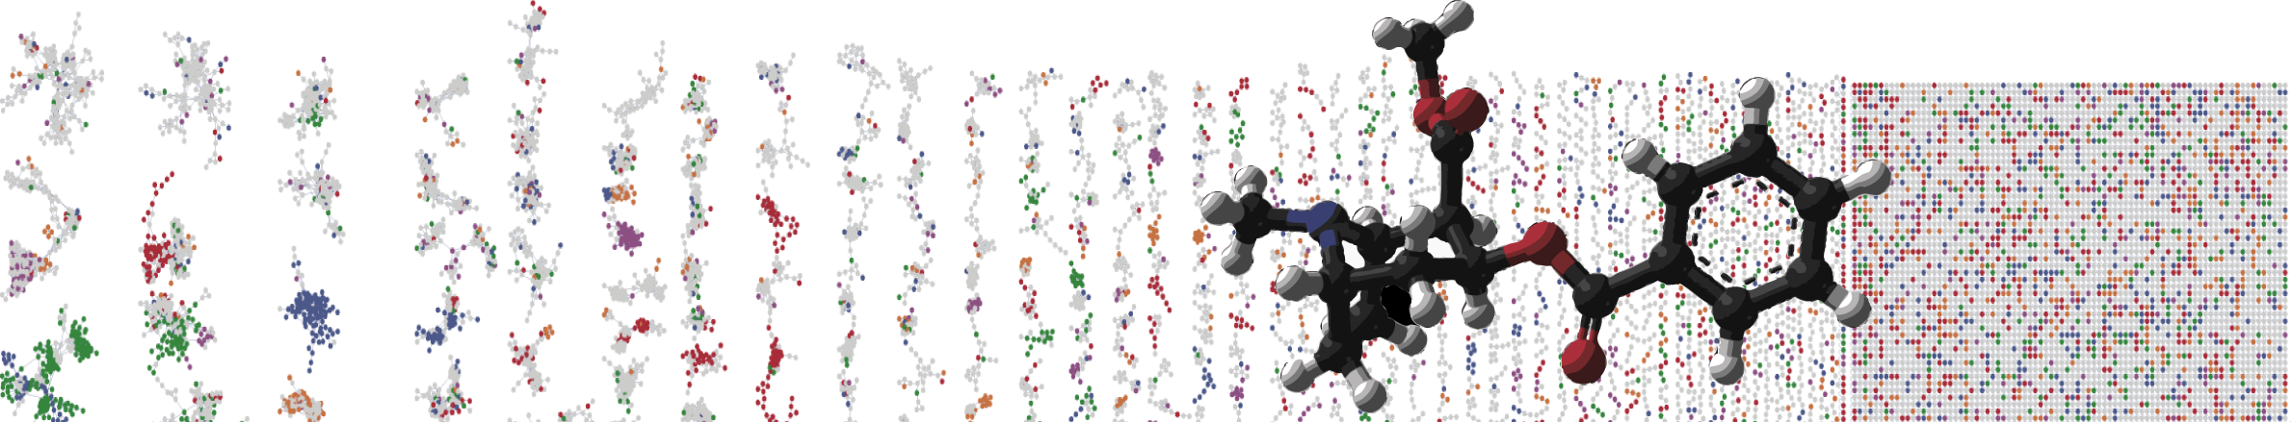


PCoA Visualization with GNPS
Hands On
ENTER AUTHORS HERE
University of California - San Diego

Slide 2
Objectives and Data
Utilize GNPS online interface
Explore PCoA plots
Link to the GNPS job: https://gnps.ucsd.edu/ProteoSAFe/status.jsp?task=1ad7bc366aef45ce81d2dfcca0a9a5e7
Interactive Link

Slide 3
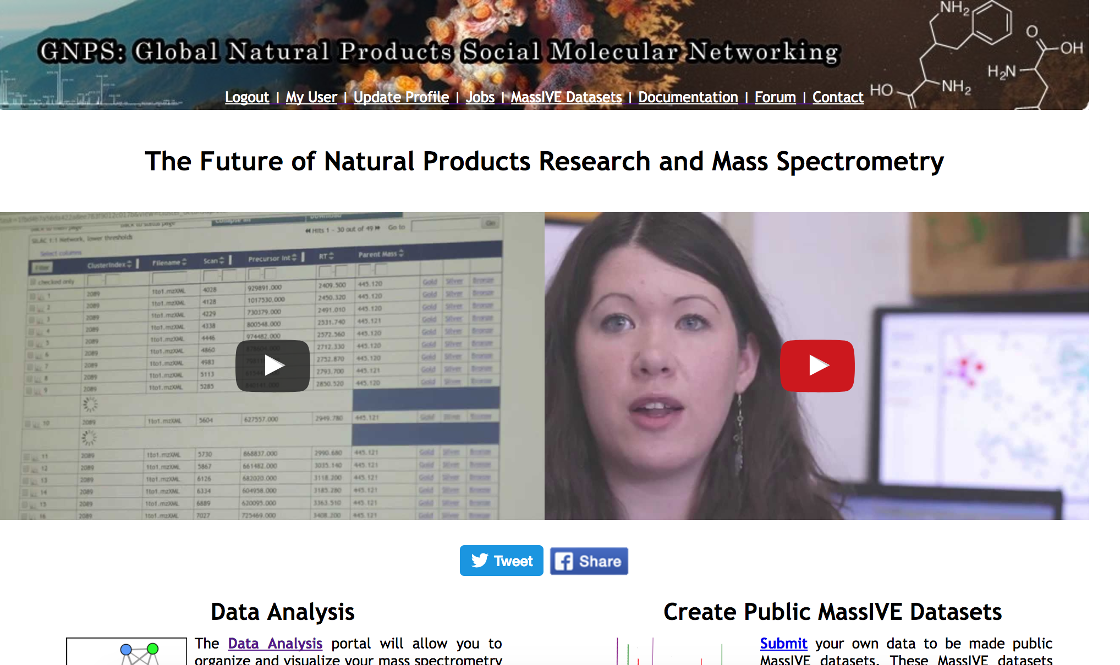
Lets analyze your molecular network.

Slide 4
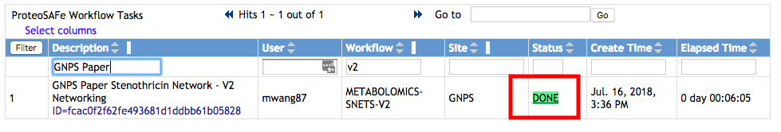
Select Done Job
Interactive Link

Slide 5
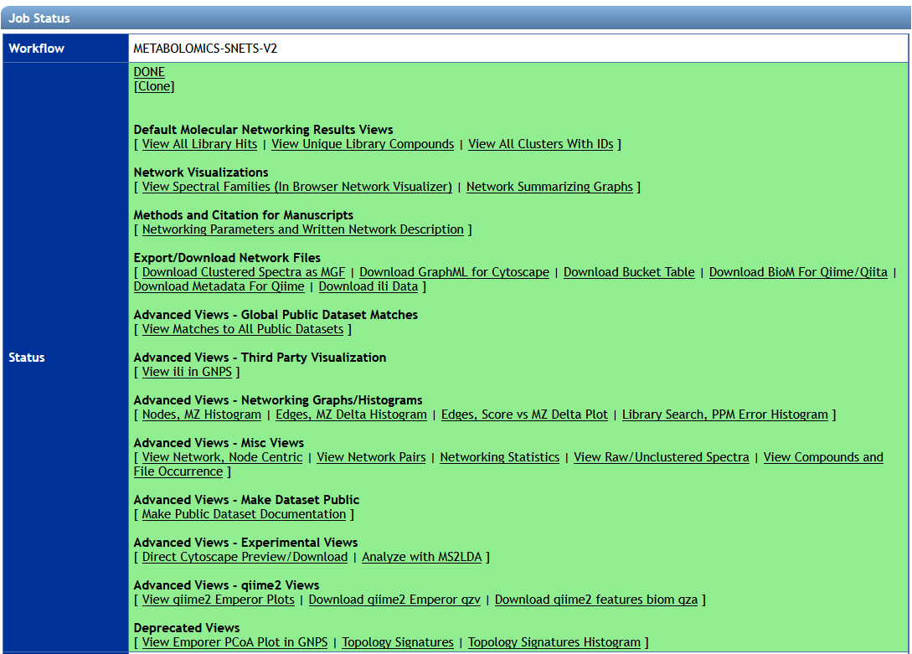
Explore Advanced Views
Interactive Link

Slide 6
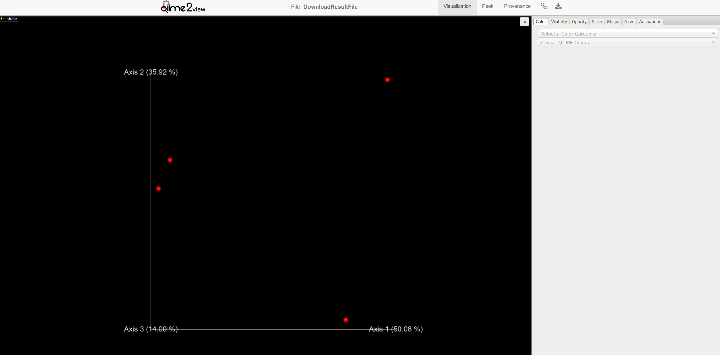
Explore PCoA Emperor plot
Interactive Link
GNPS Tutorial Module - PCoA Exploration

Slide 7
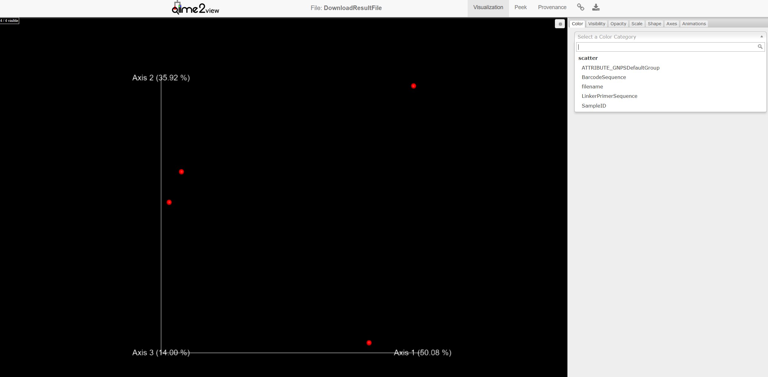
Explore PCoA Emperor plot
Interactive Link
GNPS Tutorial Module - PCoA Exploration

Slide 8
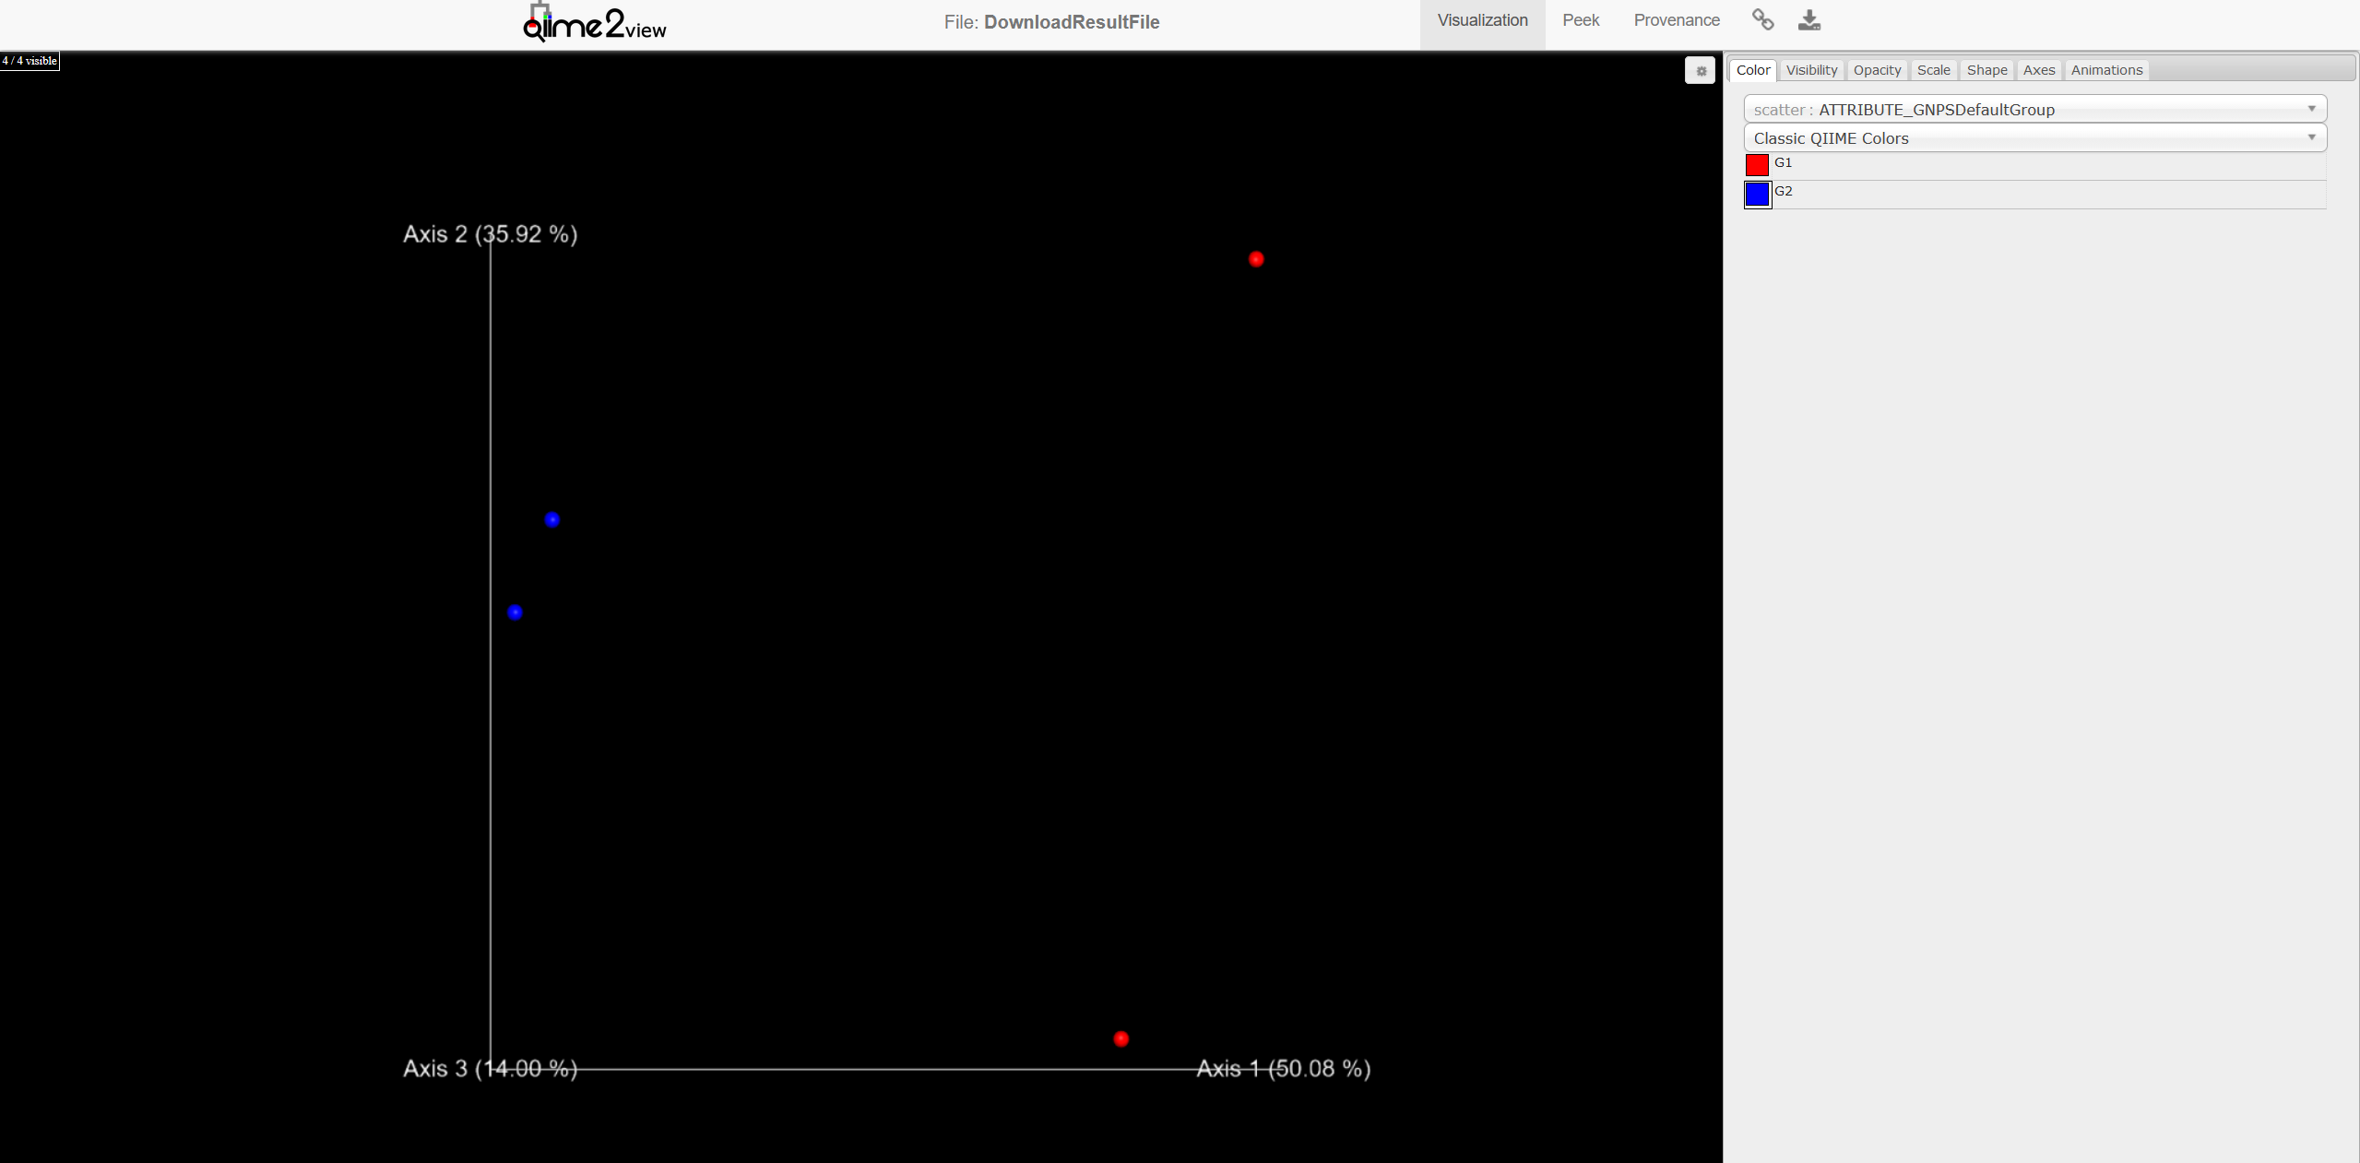
Explore PCoA Emperor plot
Interactive Link
GNPS Tutorial Module - PCoA Exploration

Slide 9
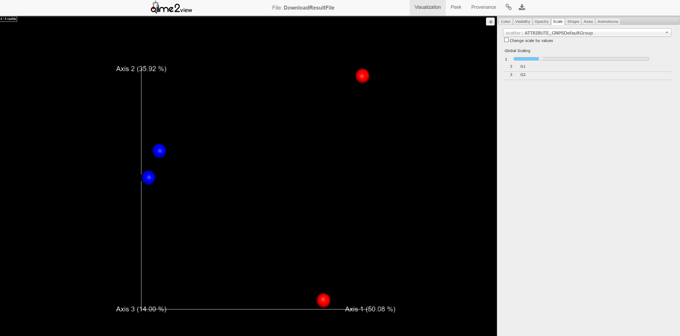
Explore PCoA Emperor plot
Interactive Link
GNPS Tutorial Module - PCoA Exploration

Slide 10
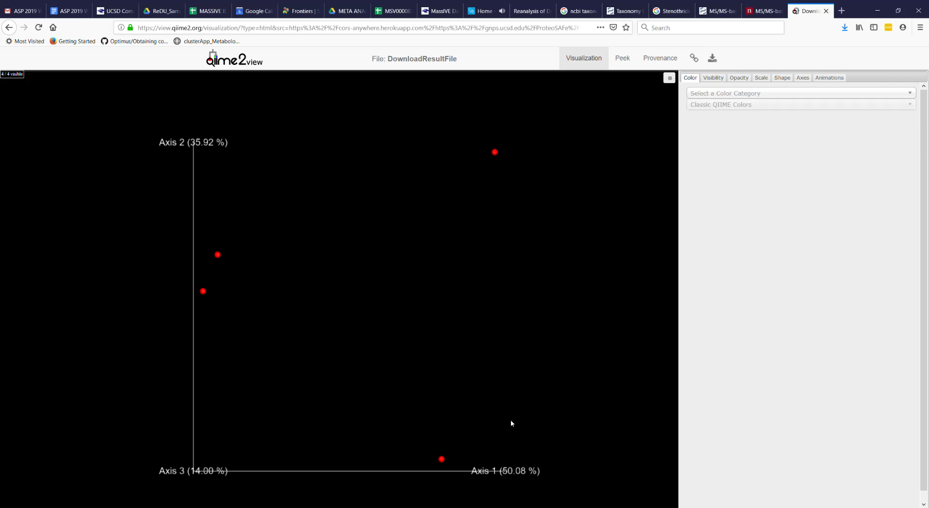
Explore PCoA Emperor plot
Short video
Interactive Link
GNPS Tutorial Module - PCoA Exploration

Slide 11
Questions, Problems or Bugs?
Documentation: https://ccms-ucsd.github.io/GNPSDocumentation/
Forum: https://groups.google.com/forum/#!forum/molecular_networking_bug_reports
PRESENTER NAMES AND EMAILS HERE

